Slide 1
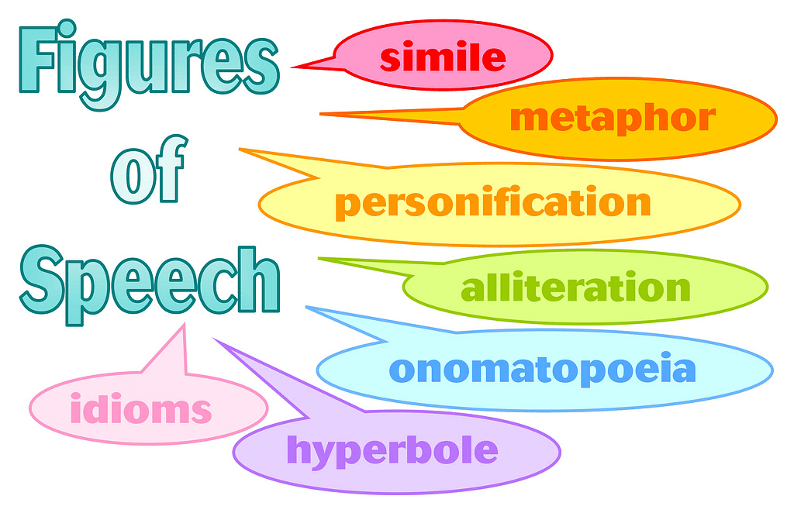

Slide 10
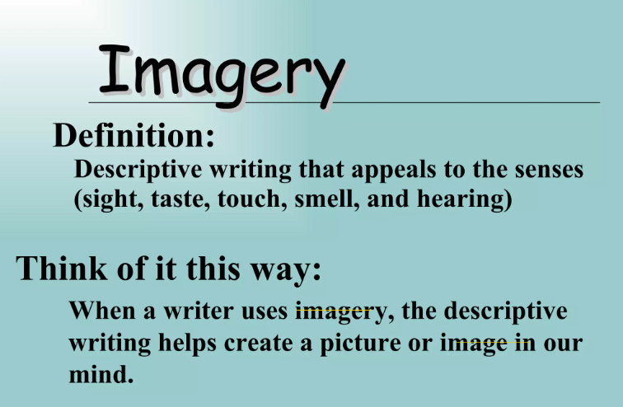

Slide 12
Nithya Prakash /FACULTY/English/SNSACD

Slide 13
Nithya Prakash /FACULTY/English/SNSACD

